Slide 1
06 - Intro to ML
Machine Learning

Slide 2
Course Overview:
1.1 - Python Review
1.2 - Numpy
1.3 - Pandas
1.4 - Seaborn
2.1 - ML Intro
2.2 - Linear Regression
2.3 - Logistic Regression
2.4 -Naïve Bayes Classifier
2.5 - KNN
2.6 - Decision Trees
3.1 – Ensembling Learning
3.2 - Neural Networks
4.* - Natural Language Processing (NLP)
5.* Competition Tips & Final Thoughts

Slide 3
Types of Machine Learning
01
Classification vs. Regression
02
Table of Contents
04
Training Models Pipeline
Terminology of Supervised Learning
03
05
Evaluating Models
06
Bias-Variance Tradeoff

Slide 4
01
Types of ML

Slide 5
Types of Machine Learning
Data Sets
Dynamic Scenarios
Supervised Learning
Unsupervised Learning
Reinforcement Learning
Predictions
Clusters
Actions

Slide 6
02
Classification vs. Regression

Slide 7
Types of Supervised Tasks
Classification
Regression
Categories
Numbers

Slide 8
03
Terminology of Supervised Learning

Slide 9
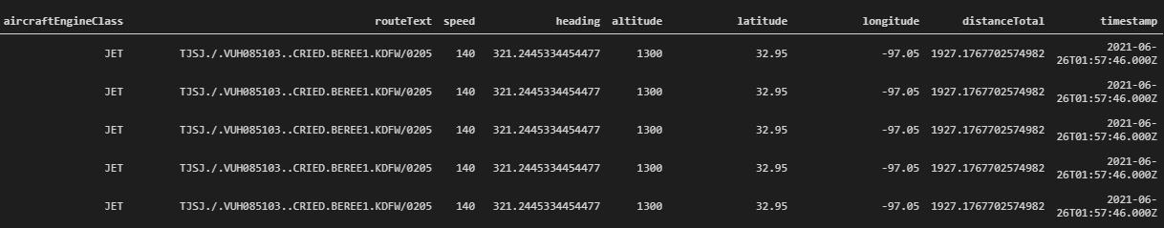
Features and Targets
Features - “X”
Target Value / Label / Ground Truth - “Y”

Slide 10
04
Training Pipeline

Slide 11
Training and Validating
Training Set
Test Set
Train model for y with X values.
Roughly 60-80% of entire data set
Validate accuracy of model on test X values.
Compare to y values

Slide 12
05
Evaluating Models

Slide 13
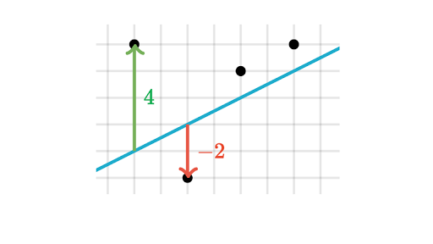
Regression - Residuals
Residuals
Khan Academy

Slide 14
Regression - Common Metrics
MAE
MSE
RMSE
Mean Absolute Error:
Take the sum of the absolute values of the residuals and divide by the number of points.
Mean Squared Error:
Take the sum of the squared values of the residuals and divide by the number of points.
Root Mean Squared Error:
Take the square root of the mean squared error value - oftentimes more interpretable

Slide 15

Classification - Accuracy
Accuracy is a common metric for classification
Simple and easy to interpret
However, doesn’t tell the entire story

Slide 16
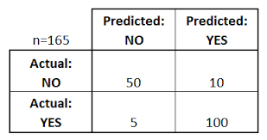
Classification - Confusion Matrix
Given a binary classification task:
False Negative: incorrectly predicts negative
False Positive: incorrectly predicts positive
Can be represented by a confusion matrix
Applies to more than binary classification
dataschool.io

Slide 17


Classification - F1 Score
Recall:
Higher value means less FN’s
Precision:
Higher value means less FP’s
F1 Score:
Harmonic mean of precision and recall
If either is low, F1 Score will be low
Useful for imbalance data sets

Slide 18
06
Overfitting and Underfitting

Slide 19
Overfitting and Underfitting
Overfitting
Underfitting
When model fits well to train set but badly to test data set.
Doesn’t generalize enough.
When model fits badly to the train set and the test set.
It is too simple to capture the underlying patterns.

Slide 20
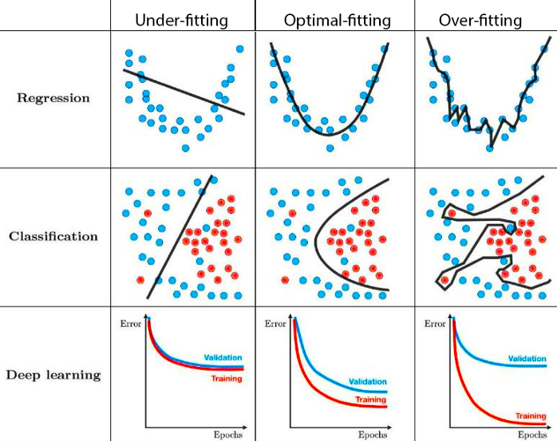
Examples
https://towardsdatascience.com/techniques-for-handling-underfitting-and-overfitting-in-machine-learning-348daa2380b9

Slide 21
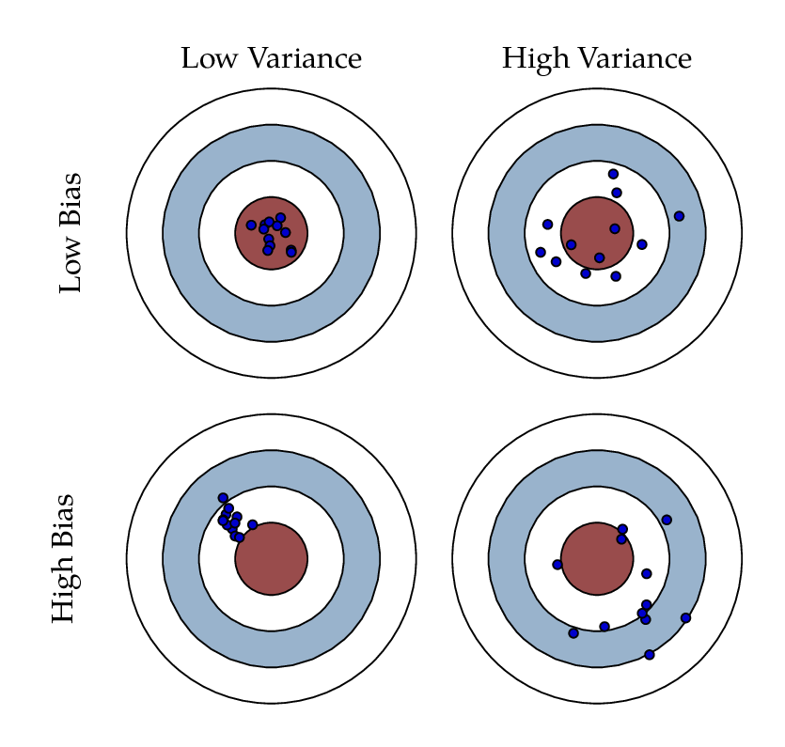
Bias and Variance
Bias (suggests underfitting if high):
How much predictions vary from the target value
Variance (suggests overfitting if high):
how much predictions would change if different training values would use
Ideal is low bias low variance
However, often need to make tradeoffs based off of domain knowledge
endtoend.ai

